Slide 1



Embedded Software

Slide 2
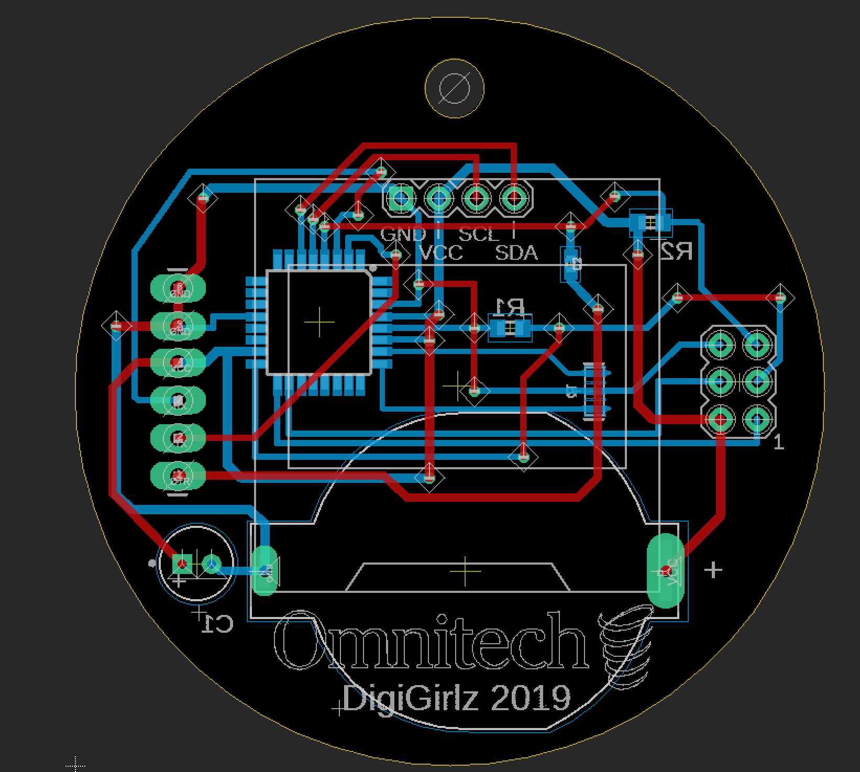
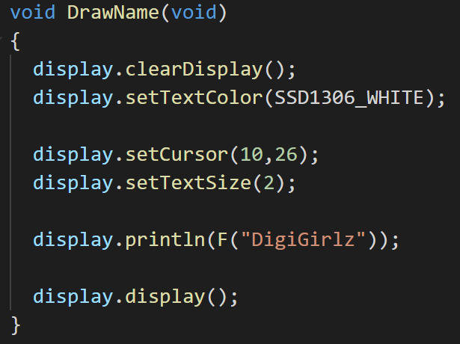
Hardware Vs Software
Hardware consists of the physical parts of a computer.
Software refers to the instructions that can be stored by and run on hardware.
Hardware is hard to change but software is usually much easier to change.

Slide 3
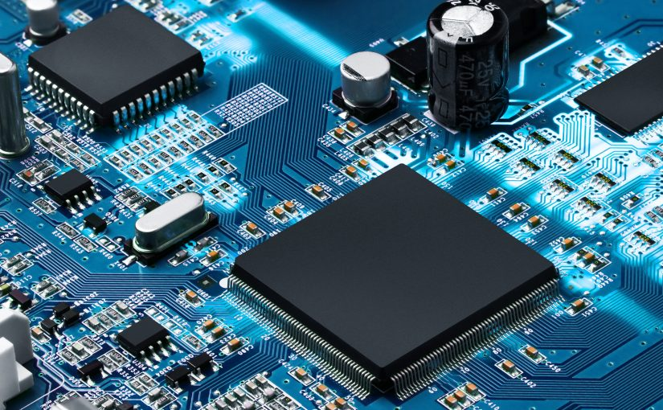
Embedded?
Embedded software is computer software written to control machines or devices that are not typically thought of as computers
Embedded software may have no user interface or OS
Embedded software can be inside components of larger computers

Slide 4
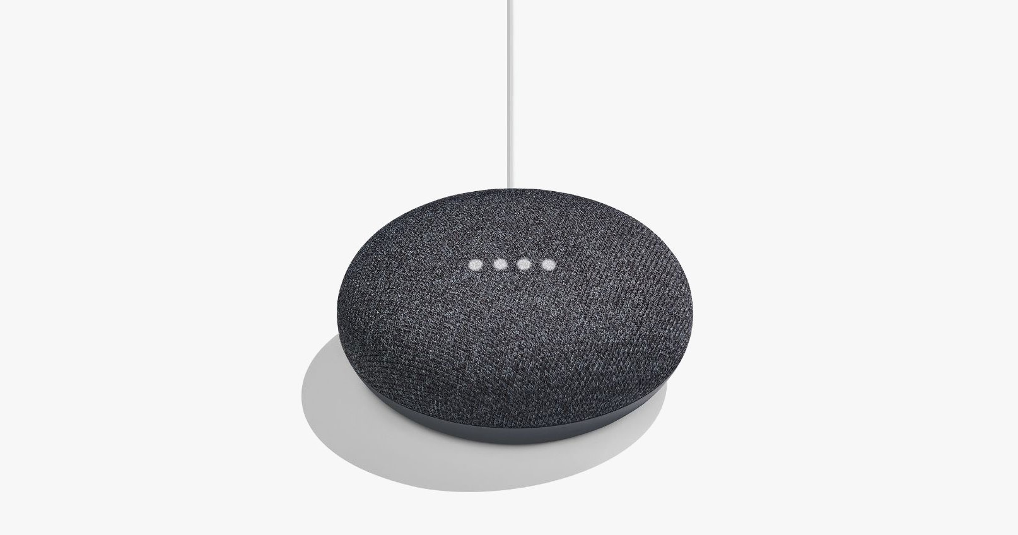
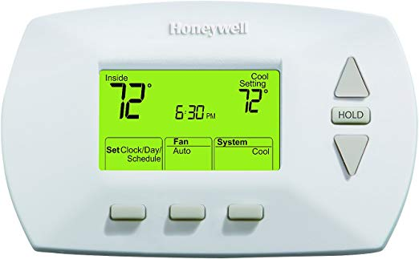


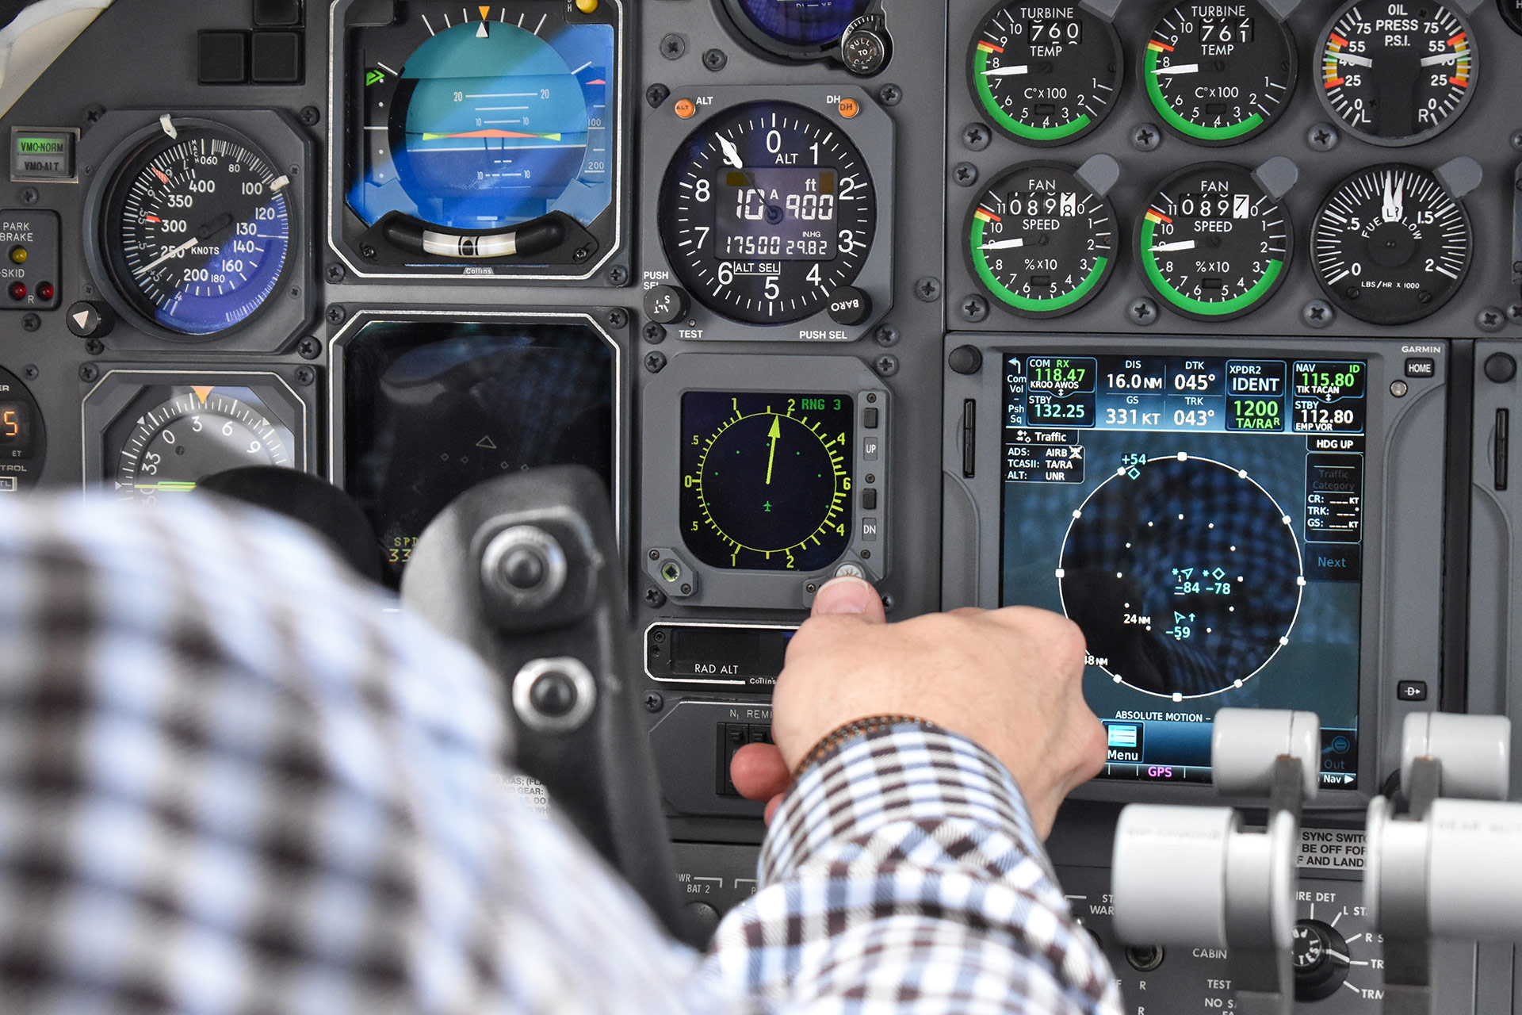
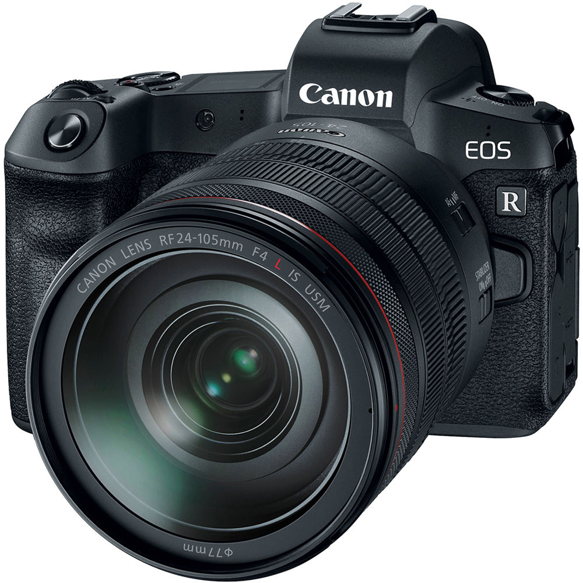
Examples

Slide 5
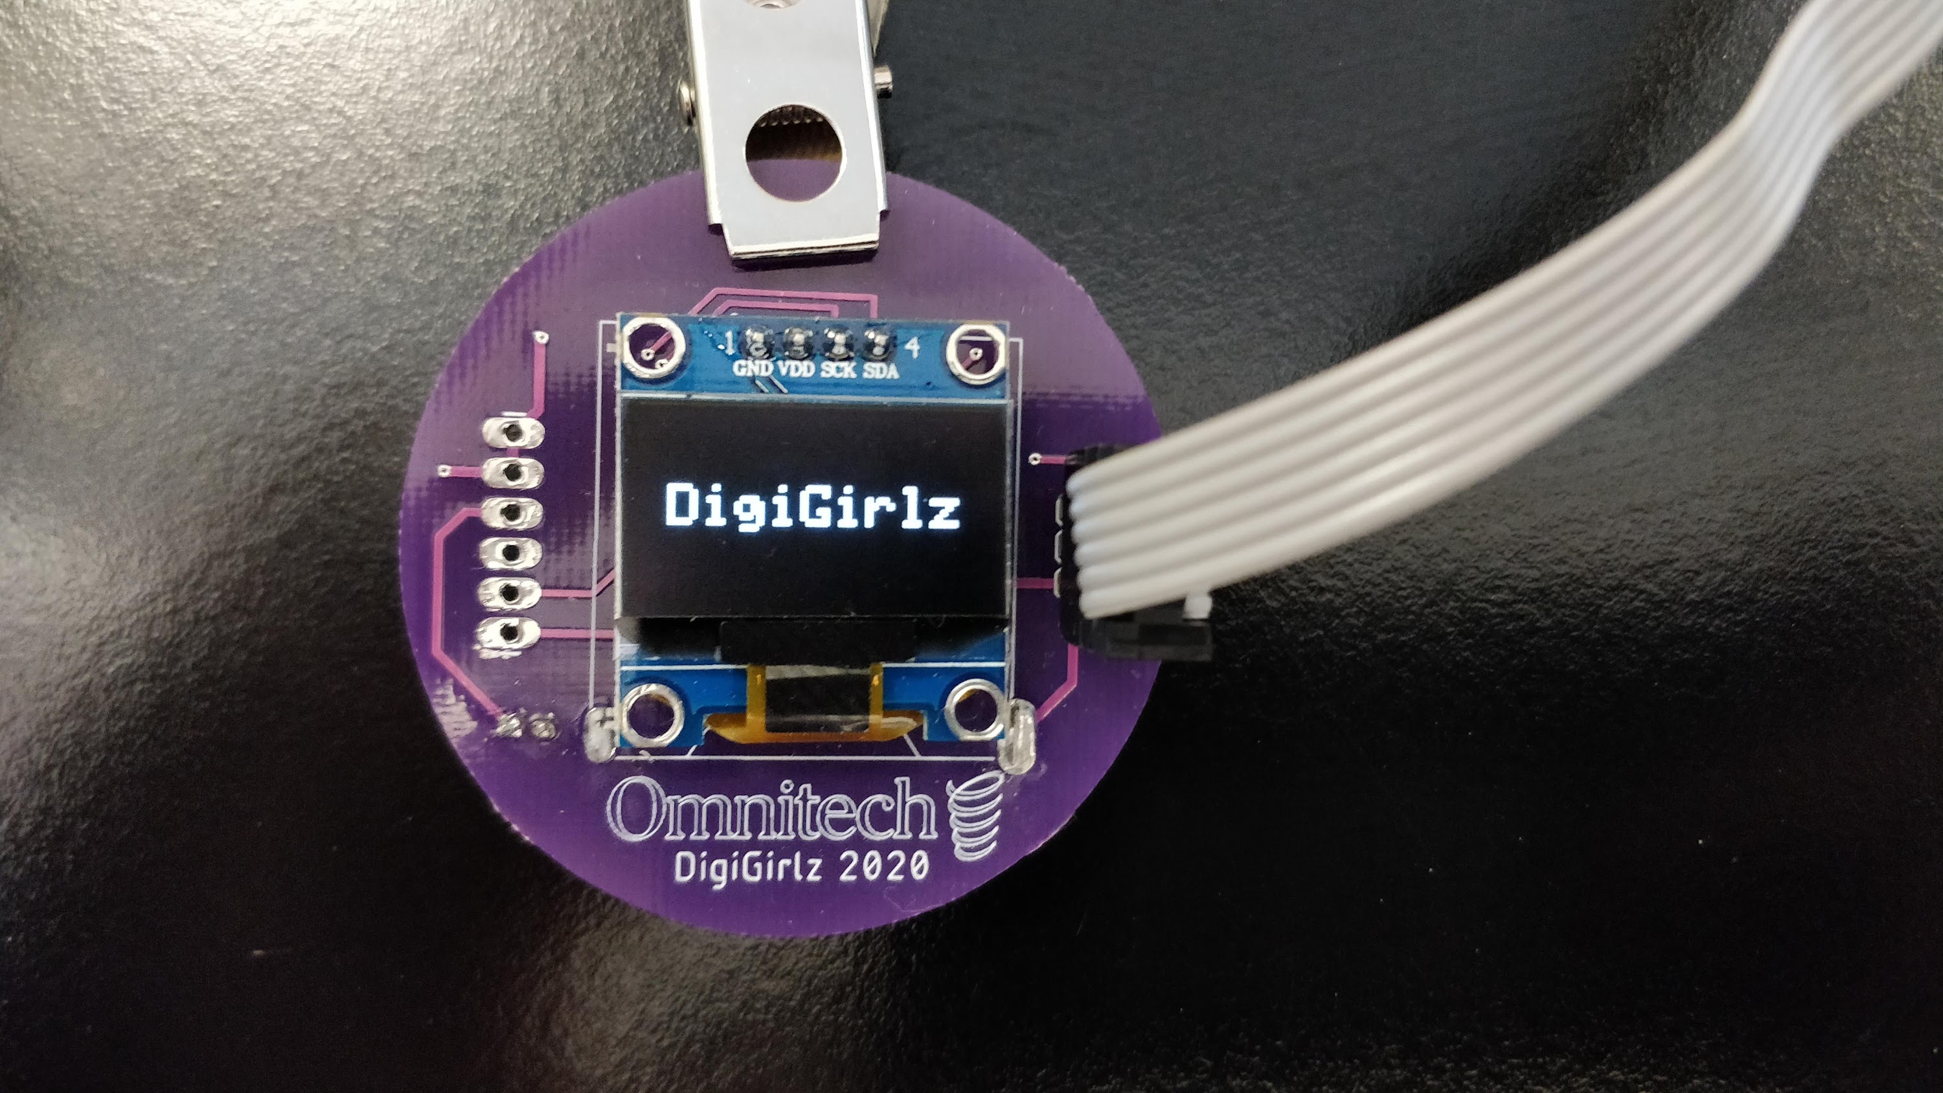
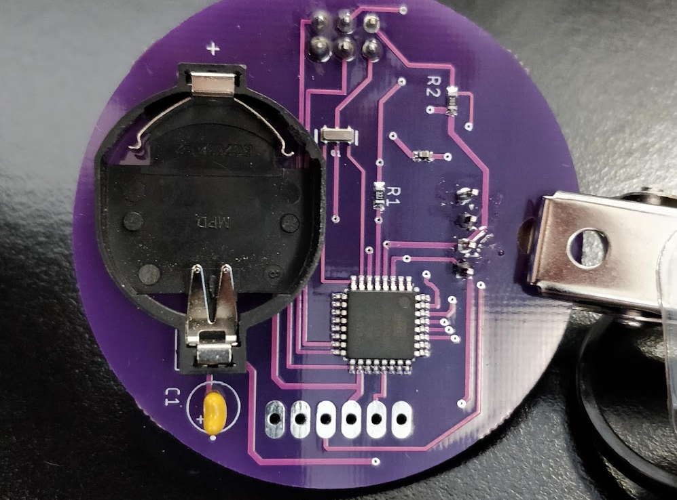
This session
This embedded system is a programmable name badge designed by Omnitech.
In this session, you will learn a bit about the badge, learn how to make the badge display your name, and get to keep the badge when you’re done.

Slide 6

Code: how to write software
Today we’ll be using Arduino, a beginner level tool that uses code similar to C++
You’ll learn how to edit a basic program to make the badge display your name
You can experiment more at home!

Slide 7
Getting started
Unpack your badge from its bag
Plug the programmer into your computer
Plug the programming cable into the badge as shown on the next slide
The badge should power-on

Slide 8
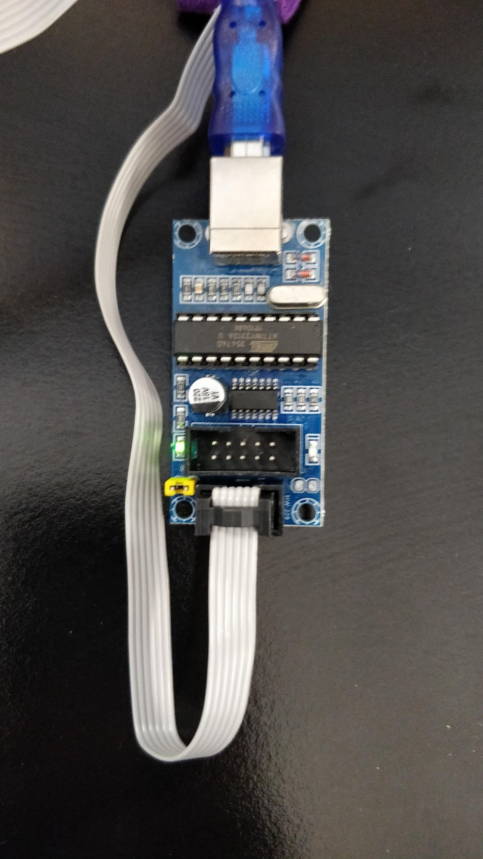
Getting Started

Slide 9
The basics
It looks complicated, but it really isn’t!
When the badge powers-on, it runs the code under “setup”
After it runs setup, it runs “loop” forever
The badge does these things in order:
Starts talking to the display module
Clears the screen
Draws the Omnitech Logo
Sleeps for a bit
Draws some text (DigiGirlz)
Sleeps forever

Slide 10
The Badge: An embedded system
The badge only has 8 major components. Most of them are just for regulating power from the battery.
The processor is the square, black component on the back. It is much slower than a normal computer, but works well for small tasks, like this badge.
It only has 0.01% as much memory as a normal laptop computer (2 kB)
It has 0.006% as much storage as a normal laptop (32 kB)
It is overall about 0.5% as fast as modern computers (16 MHz)

Slide 11
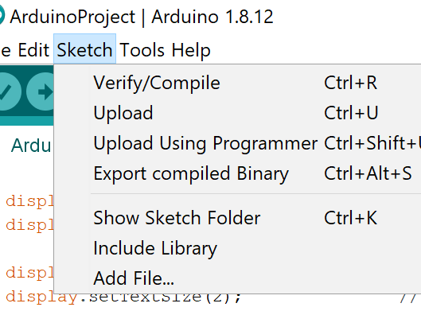
Display Your Name
Find the DrawName method
Change “DigiGirlz” to your name
You might need to change the text size to 1, or move the cursor position to make your name fit.
Upload your program to the badge by clicking “Sketch” then ”Upload Using Programmer”

Slide 12
More Resources
You can download everything from today’s session, including this presentation and advanced project from my GitHub! https://github.com/ad3154/DigiGirlzBadge
The advanced project includes drawing circles, triangles, scrolling text, and more. Try it out when you get home!
The badge schematics are also available online.

Slide 13
Careers
If you liked this session, some careers you might be interested in include:
Electrical Engineering
Computer Engineering
Computer Science

